Slide 1
NAACL 2013 Report
Fei Liu
July 2, 2013

Slide 2

Logistics
Tutorials: June 09
Main Conference: June 10 – 12
Workshops: June 13 – 15
Joint NAACL/ICML Symposium: June 15
Location
Westin Peachtree Hotel, Atlanta, Georgia

Slide 3
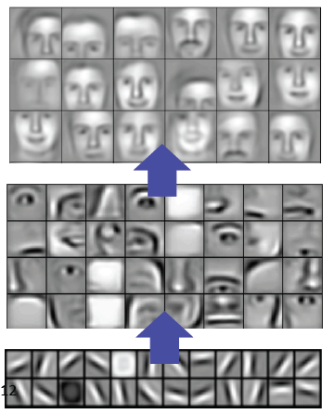
Tutorials (1/2)
Deep Learning for NLP
Richard Socher and Chris Manning, Stanford
Take-home message
Learning multiple levels of latent representations
Unsupervised pre-training is a key factor

Slide 4
Tutorials (2/2)
Spectral Learning Algorithms for NLP
Cohen, Collins, Stratos, Columbia
Foster, Ungar, UPenn
Take-home message
Use CCA (canonical correlation analysis) to learn low dimensional representation
Learned word representations maximize the correlation between contrasting views

Slide 5
Papers (1/6)
Relation Extraction with Matrix Factorization and Universal Schemas
Riedel, UCL, Yao, McCallum, Marlin, Umass
Take-home message
Universal schema: union of surface form predicates as in OpenIE and relations in the schemas of pre-existing databases
Learn latent vectors for entity tuples and relations, used to populate the database

Slide 6
Papers (2/6)
Learning a Part-of-Speech Tagger From Two Hours of Annotation
Dan Garrette, Jason Baldridge, UT Austin
I am hopeful that Garrette and Baldridge’s approach will encourage NLP researchers to write more papers that fall into the category “Look Mom! I improved the state-of-the-art with only $250 of investment in data annotation” and fewer papers that fall into the category “Look Mom! I spent three years of my life and no money on data annotation, but I got a system that is 53% below the state of the art.”
-- Daniel Marcu

Slide 7
Papers (3/6)
PPDB: The Paraphrase Database
Juri Ganitkevitch, Benjamin Van Durme, JHU, Chris Callison-Burch, UPenn
Take-home message
Over 220 million paraphrase pairs
Capture meaning-preserving syntactic transformations

Slide 8
Papers (4/6)
Automatic Generation of English Respellings
Bradley Hauer, Grzegorz Kondrak, U Alberta
Take-home message
Best student paper
Map English spellings to pronunciations
E.g., “Huatulco” (Mexican resort)
→ “wah-tool-koh”

Slide 9
Papers (5/6)

Slide 10
Papers (6/6)

Slide 11
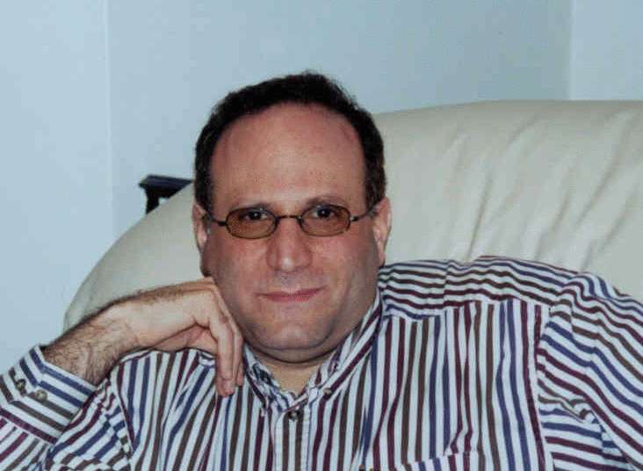
Symposium (1/3)
Learning to Say What You See and See What You Say
Jeff Siskind, Purdue
Video In Sentence Out
Demo Video

Slide 12
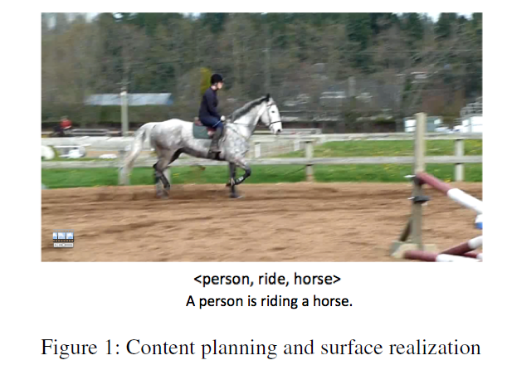
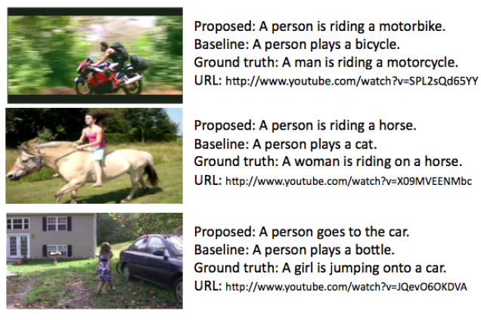
Symposium (2/3)
Generating Natural-Language Video Descriptions Using Text-Mined Knowledge
Ray Mooney, UT Austin

Slide 13
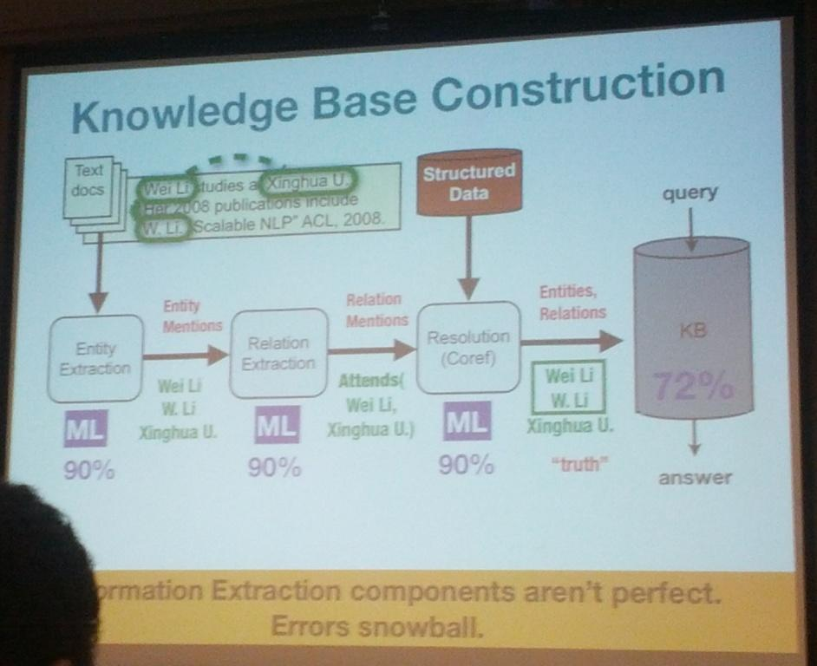
Symposium (3/3)
Parallel, Distributed and Sparse Computation for Automated Knowledge Base Construction
Andrew McCallum
UMass

Slide 14
Thank You!

